Slide 1
Module 4
Object Detection Part I
Lecture 9 -

Slide 2
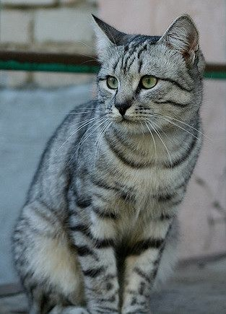
Image Classification: A core task in Computer Vision
(assume given a set of possible labels)
{dog, cat, truck, plane, ...}
cat
This image by Nikita is licensed under CC-BY 2.0
Lecture 9 -

Slide 3
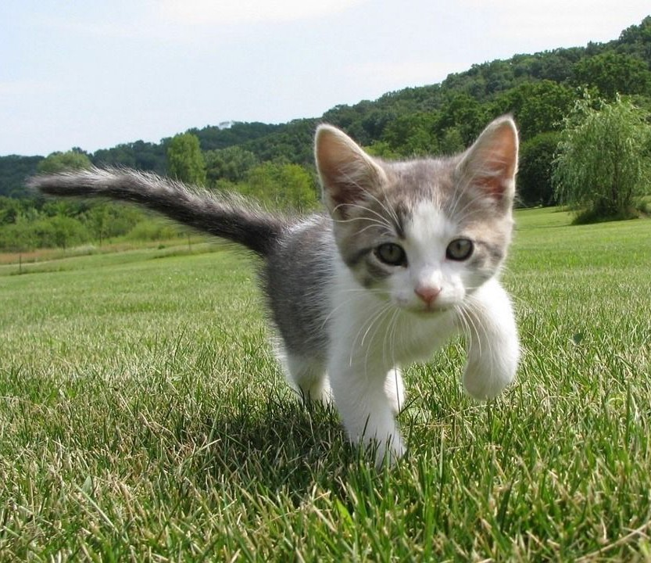
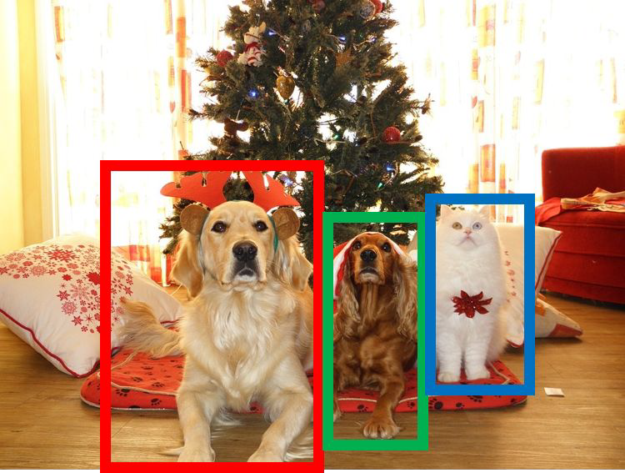

Computer Vision Tasks
Semantic Segmentation
Object Detection
Instance Segmentation
Classification
CAT
GRASS, CAT, TREE, SKY
DOG, DOG, CAT
DOG, DOG, CAT
No spatial extent
No objects, just pixels
Multiple Object
This image is CC0 public domain
Lecture 9 -

Slide 4
Semantic Segmentation
Semantic Segmentation
Object Detection
Instance Segmentation
Classification
CAT
GRASS, CAT, TREE, SKY
DOG, DOG, CAT
DOG, DOG, CAT
No spatial extent
No objects, just pixels
Multiple Object
Lecture 9 -

Slide 5
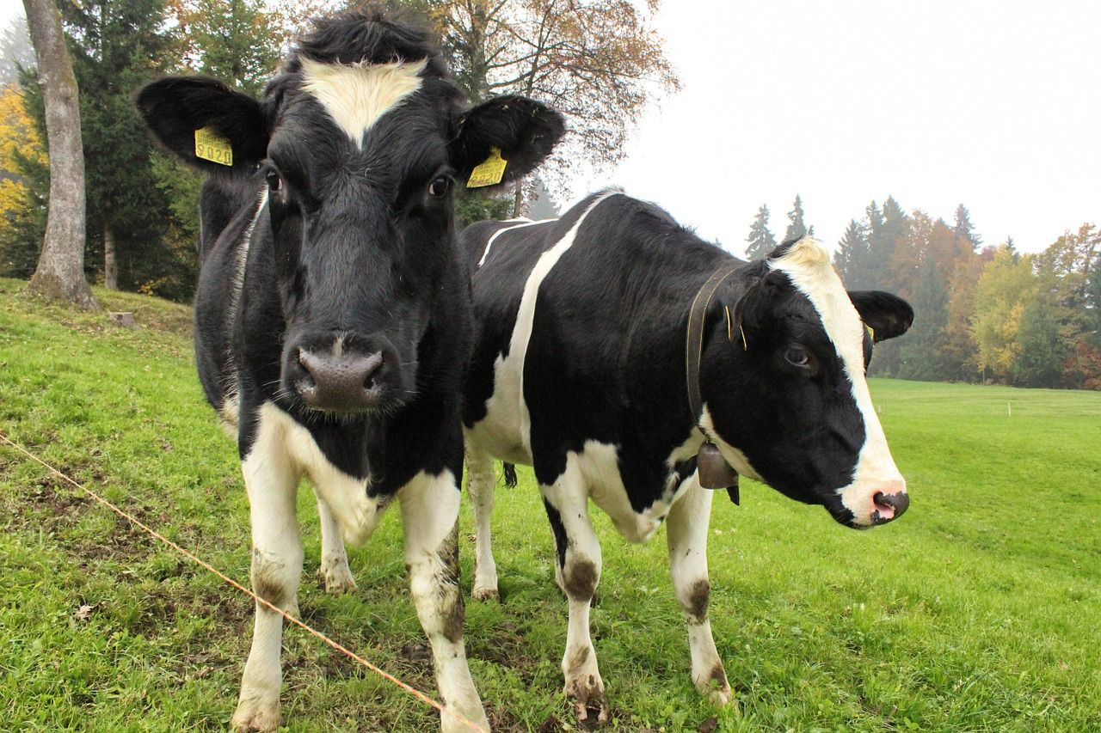
Semantic Segmentation: The Problem
?
GRASS, CAT, TREE, SKY, ...
Paired training data: for each training image, each pixel is labeled with a semantic category.
At test time, classify each pixel of a new image.
Lecture 9 -

Slide 6
Object Detection
Semantic Segmentation
Object Detection
Instance Segmentation
Classification
CAT
GRASS, CAT, TREE, SKY
DOG, DOG, CAT
DOG, DOG, CAT
No spatial extent
No objects, just pixels
Multiple Object
Lecture 9 -

Slide 7
Object Detection
Semantic Segmentation
Object Detection
Instance Segmentation
Classification
CAT
GRASS, CAT, TREE, SKY
DOG, DOG, CAT
DOG, DOG, CAT
No spatial extent
No objects, just pixels
Multiple Object
Lecture 9 -

Slide 8
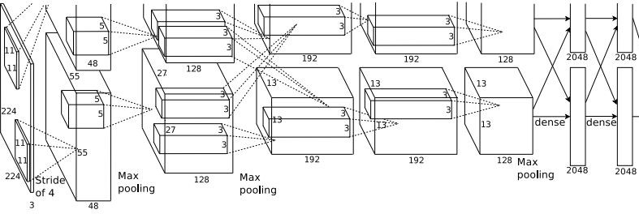
Object Detection: Single Object
(Classification + Localization)
Class Scores
Cat: 0.9
Dog: 0.05
Car: 0.01
...
Fully Connected: 4096 to 1000
x, y
h
w
Fully Connected: 4096 to 4
Vector:
4096
This image is CC0 public domain
Box Coordinates (x, y, w, h)
Lecture 9 -

Slide 9
Object Detection: Single Object
(Classification + Localization)
Correct label:
Cat
Class Scores
Fully Connected: 4096 to 1000
Cat: 0.9
Dog: 0.05
Car: 0.01
...
Softmax Loss
x, y
h
w
Fully Connected: 4096 to 4
Vector:
4096
This image is CC0 public domain
Box Coordinates
L2 Loss
(x, y, w, h)
Treat localization as a regression problem!
Correct box: (x’, y’, w’, h’)
Lecture 9 -

Slide 10
Object Detection: Single Object
(Classification + Localization)
Correct label:
Cat
Class Scores
Fully Connected: 4096 to 1000
Cat: 0.9
Dog: 0.05
Car: 0.01
...
Softmax Loss
x, y
Multitask Loss
+
h
Loss
w
Fully Connected: 4096 to 4
Vector:
4096
This image is CC0 public domain
Box Coordinates
L2 Loss
(x, y, w, h)
Treat localization as a regression problem!
Correct box: (x’, y’, w’, h’)
Lecture 9 -

Slide 11
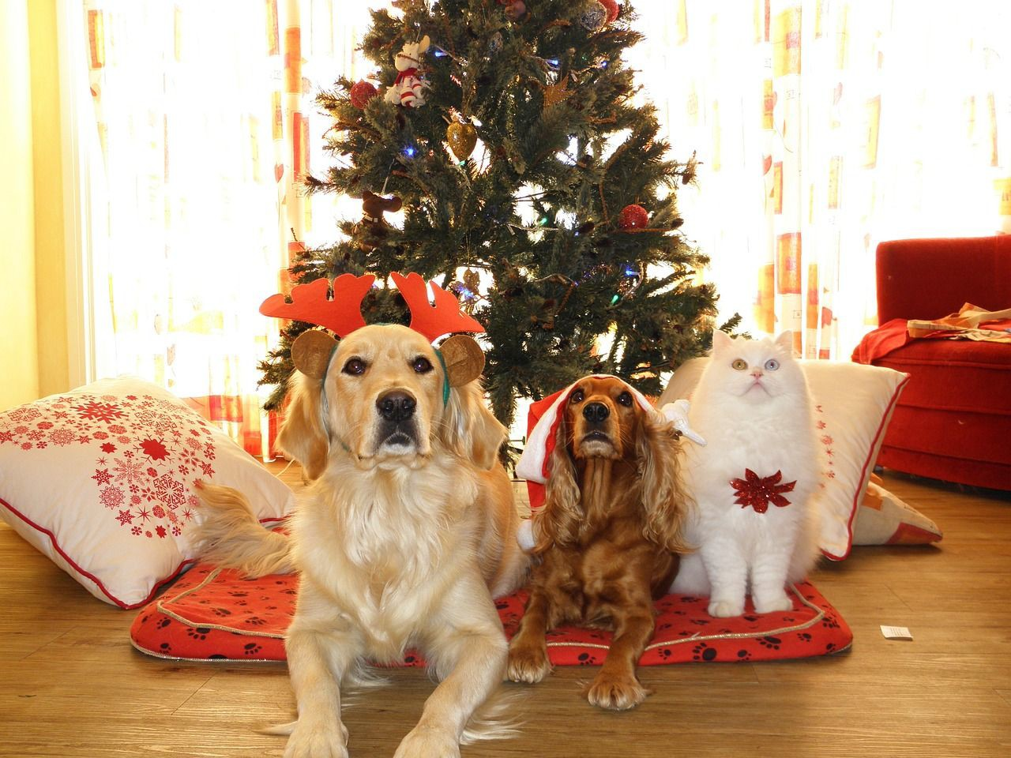
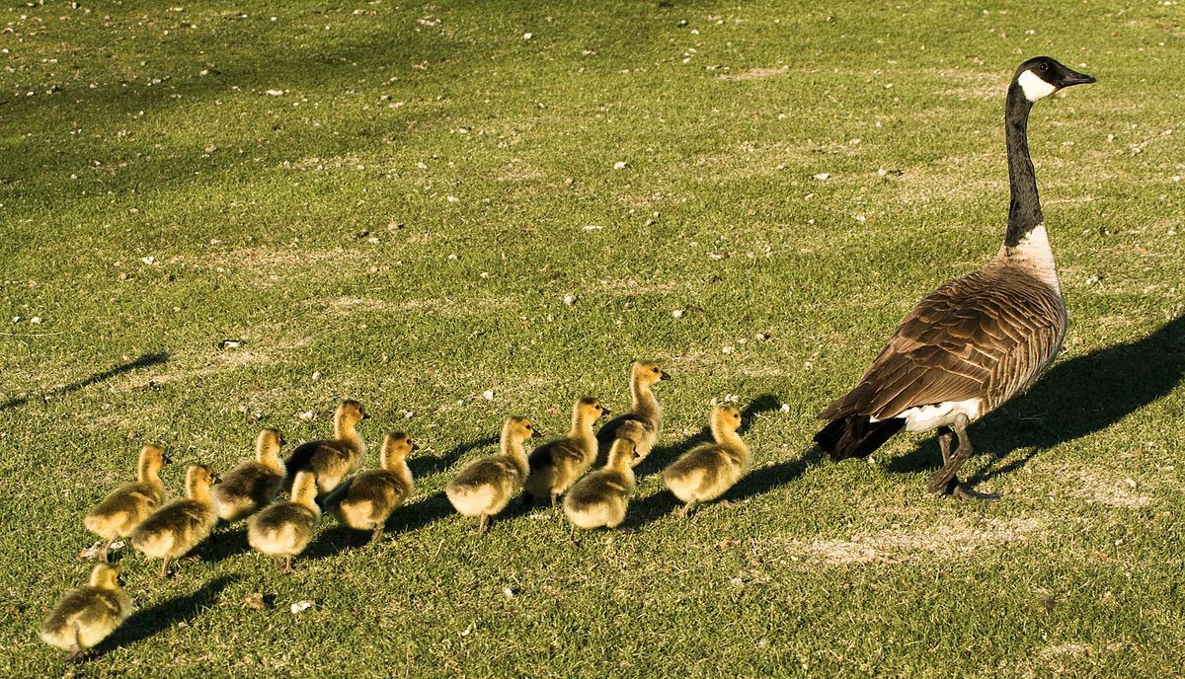
Object Detection: Multiple Objects
CAT: (x, y, w, h)
DOG: (x, y, w, h)
DOG: (x, y, w, h)
CAT: (x, y, w, h)
DUCK: (x, y, w, h)
DUCK: (x, y, w, h)
….
Lecture 9 -

Slide 12
Each image needs a different number of outputs!
Object Detection: Multiple Objects
CAT: (x, y, w, h)
4 numbers
DOG: (x, y, w, h)
DOG: (x, y, w, h)
CAT: (x, y, w, h)
12 numbers
DUCK: (x, y, w, h)
DUCK: (x, y, w, h)
….
Many numbers!
Lecture 9 -

Slide 13
Object Detection: Multiple Objects
Apply a CNN to many different crops of the image, CNN classifies each crop as object or background
Dog? NO Cat? NO
Background? YES
Lecture 9 -

Slide 14
Object Detection: Multiple Objects
Apply a CNN to many different crops of the image, CNN classifies each crop as object or background
Dog? YES
Cat? NO Background? NO
Lecture 9 -

Slide 15
Object Detection: Multiple Objects
Apply a CNN to many different crops of the image, CNN classifies each crop as object or background
Dog? YES
Cat? NO Background? NO
Lecture 9 -

Slide 16
Object Detection: Multiple Objects
Apply a CNN to many different crops of the image, CNN classifies each crop as object or background
Dog? NO Cat? YES
Background? NO
Q: What’s the problem with this approach?
Lecture 9 -

Slide 17
Object Detection: Multiple Objects
Apply a CNN to many different crops of the image, CNN classifies each crop as object or background
Dog? NO Cat? YES
Background? NO
Problem: Need to apply CNN to huge number of locations, scales, and aspect ratios, very computationally expensive!
Lecture 9 -

Slide 18

Region Proposals: Selective Search
Find “blobby” image regions that are likely to contain objects
Relatively fast to run; e.g. Selective Search gives 2000 region proposals in a few seconds on CPU
Alexe et al, “Measuring the objectness of image windows”, TPAMI 2012 Uijlings et al, “Selective Search for Object Recognition”, IJCV 2013
Cheng et al, “BING: Binarized normed gradients for objectness estimation at 300fps”, CVPR 2014 Zitnick and Dollar, “Edge boxes: Locating object proposals from edges”, ECCV 2014
Lecture 9 -

Slide 19
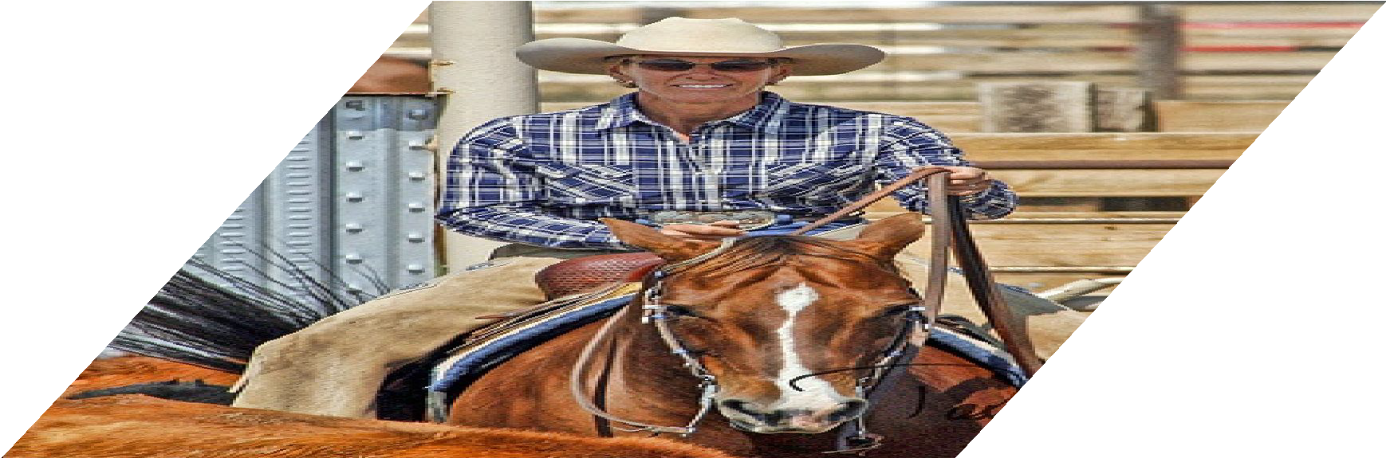
R-CNN
Girshick et al, “Rich feature hierarchies for accurate object detection and semantic segmentation”, CVPR 2014.
Figure copyright Ross Girshick, 2015; source. Reproduced with permission.
Input image
Lecture 9 -

Slide 20
R-CNN
Regions of Interest (RoI) from a proposal method (~2k)
Girshick et al, “Rich feature hierarchies for accurate object detection and semantic segmentation”, CVPR 2014.
Figure copyright Ross Girshick, 2015; source. Reproduced with permission.
Input image
Lecture 9 -

Slide 21
R-CNN
Warped image regions (224x224 pixels)
Regions of Interest (RoI) from a proposal method (~2k)
Girshick et al, “Rich feature hierarchies for accurate object detection and semantic segmentation”, CVPR 2014.
Figure copyright Ross Girshick, 2015; source. Reproduced with permission.
Input image
Lecture 9 -

Slide 22


R-CNN
Forward each region through ConvNet (ImageNet-pretranied)
ConvN et
ConvN et
ConvN et
Warped image regions (224x224 pixels)
Regions of Interest
(RoI) from a proposal method (~2k)
Girshick et al, “Rich feature hierarchies for accurate object detection and semantic segmentation”, CVPR 2014.
Figure copyright Ross Girshick, 2015; source. Reproduced with permission.
Input image
Lecture 9 -

Slide 23



R-CNN
SVMs
Classify regions with SVMs
SVMs
SVMs
Forward each region through ConvNet (ImageNet-pretranied)
ConvN et
ConvN et
ConvN et
Warped image regions (224x224 pixels)
Regions of Interest
(RoI) from a proposal method (~2k)
Girshick et al, “Rich feature hierarchies for accurate object detection and semantic segmentation”, CVPR 2014.
Figure copyright Ross Girshick, 2015; source. Reproduced with permission.
Input image
Lecture 9 -

Slide 24


R-CNN
Predict “corrections” to the RoI: 4 numbers: (dx, dy, dw, dh)
Bbox reg
SVMs
Classify regions with SVMs
Bbox reg
SVMs
Bbox reg
SVMs
Forward each region through ConvNet (ImageNet-pretranied)
ConvN et
ConvN et
ConvN et
Warped image regions (224x224 pixels)
Regions of Interest
(RoI) from a proposal method (~2k)
Girshick et al, “Rich feature hierarchies for accurate object detection and semantic segmentation”, CVPR 2014.
Figure copyright Ross Girshick, 2015; source. Reproduced with permission.
Input image
Lecture 9 -

Slide 25
R-CNN
Predict “corrections” to the RoI: 4 numbers: (dx, dy, dw, dh)
Bbox reg
SVMs
Classify regions with SVMs
Problem: Very slow! Need to do ~2k independent forward passes for each image!
Bbox reg
SVMs
Bbox reg
SVMs
Forward each region through ConvNet
ConvN et
ConvN et
ConvN et
Warped image regions (224x224 pixels)
Regions of Interest
(RoI) from a proposal method (~2k)
Girshick et al, “Rich feature hierarchies for accurate object detection and semantic segmentation”, CVPR 2014.
Figure copyright Ross Girshick, 2015; source. Reproduced with permission.
Input image
Lecture 9 -

Slide 26


“Slow” R-CNN
Predict “corrections” to the RoI: 4 numbers: (dx, dy, dw, dh)
Bbox reg
SVMs
Classify regions with SVMs
Problem: Very slow! Need to do ~2k independent forward passes for each image!
Bbox reg
SVMs
Bbox reg
SVMs
Forward each region through ConvNet
ConvN et
ConvN et
Idea: Pass the image through convnet before cropping! Crop the conv feature instead!
ConvN et
Warped image regions (224x224 pixels)
Regions of Interest
(RoI) from a proposal method (~2k)
Girshick et al, “Rich feature hierarchies for accurate object detection and semantic segmentation”, CVPR 2014.
Figure copyright Ross Girshick, 2015; source. Reproduced with permission.
Input image
Lecture 9 -

Slide 27
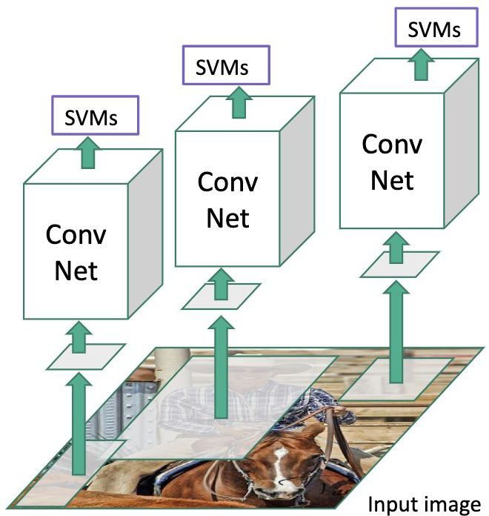

Fast R-CNN
“Slow” R-CNN
Input image
Girshick, “Fast R-CNN”, ICCV 2015. Figure copyright Ross Girshick, 2015; source. Reproduced with permission.
Lecture 9 -

Slide 28

Fast R-CNN
“Slow” R-CNN
“conv5” features
Run whole image through ConvNet
“Backbone” network: AlexNet, VGG, ResNet, etc
ConvNet
Input image
Girshick, “Fast R-CNN”, ICCV 2015. Figure copyright Ross Girshick, 2015; source. Reproduced with permission.
Lecture 9 -

Slide 29
Fast R-CNN
“Slow” R-CNN
Regions of Interest (RoIs) from a proposal
method
“conv5” features
Run whole image through ConvNet
“Backbone” network: AlexNet, VGG, ResNet, etc
ConvNet
Input image
Girshick, “Fast R-CNN”, ICCV 2015. Figure copyright Ross Girshick, 2015; source. Reproduced with permission.
Lecture 9 -

Slide 30
Fast R-CNN
“Slow” R-CNN
Regions of Interest (RoIs) from a proposal
Crop + Resize features
method
“conv5” features
Run whole image through ConvNet
“Backbone” network: AlexNet, VGG, ResNet, etc
ConvNet
Input image
Girshick, “Fast R-CNN”, ICCV 2015. Figure copyright Ross Girshick, 2015; source. Reproduced with permission.
Lecture 9 -

Slide 31



Fast R-CNN
Object category
Linear + softmax
Linear
Box offset
Per-Region Network
“Slow” R-CNN
Regions of Interest (RoIs) from a proposal
CNN
Crop + Resize features
method
“conv5” features
Run whole image through ConvNet
“Backbone” network: AlexNet, VGG, ResNet, etc
ConvNet
Input image
Girshick, “Fast R-CNN”, ICCV 2015. Figure copyright Ross Girshick, 2015; source. Reproduced with permission.
Lecture 9 -

Slide 32
Fast R-CNN
Object category
Linear + softmax
Linear
Box offset
Per-Region Network
“Slow” R-CNN
Regions of Interest (RoIs)
CNN
from a proposal
Crop + Resize features
method
“conv5” features
Run whole image through ConvNet
“Backbone” network: AlexNet, VGG, ResNet, etc
ConvNet
Input image
Girshick, “Fast R-CNN”, ICCV 2015. Figure copyright Ross Girshick, 2015; source. Reproduced with permission.
Lecture 9 -

Slide 33
Cropping Features: RoI Pool
CNN
Input Image (e.g. 3 x 640 x 480)
Image features: C x H x W (e.g. 512 x 20 x 15)
Girshick, “Fast R-CNN”, ICCV 2015.
Girshick, “Fast R-CNN”, ICCV 2015.
Lecture 9 -

Slide 34
Cropping Features: RoI Pool
Project proposal onto features
CNN
Input Image (e.g. 3 x 640 x 480)
Image features: C x H x W (e.g. 512 x 20 x 15)
Girshick, “Fast R-CNN”, ICCV 2015.
Girshick, “Fast R-CNN”, ICCV 2015.
Lecture 9 -

Slide 35
Cropping Features: RoI Pool
“Snap” to grid cells
Project proposal onto features
CNN
Input Image (e.g. 3 x 640 x 480)
Image features: C x H x W (e.g. 512 x 20 x 15)
Girshick, “Fast R-CNN”, ICCV 2015.
Lecture 9 -

Slide 36
Cropping Features: RoI Pool
“Snap” to grid cells
Project proposal onto features
Q: how do we resize the 512 x 5 x 4 region to, e.g., a 512
x 2 x 2 tensor?.
CNN
Input Image (e.g. 3 x 640 x 480)
Image features: C x H x W (e.g. 512 x 20 x 15)
Girshick, “Fast R-CNN”, ICCV 2015.
Lecture 9 -

Slide 37
Cropping Features: RoI Pool
Divide into 2x2 grid of (roughly) equal subregions
“Snap” to grid cells
Project proposal onto features
Q: how do we resize the 512 x 5 x 4 region to, e.g., a 512
x 2 x 2 tensor?.
CNN
Input Image (e.g. 3 x 640 x 480)
Image features: C x H x W (e.g. 512 x 20 x 15)
Girshick, “Fast R-CNN”, ICCV 2015.
Lecture 9 -

Slide 38
Cropping Features: RoI Pool
Divide into 2x2 grid of (roughly) equal subregions
“Snap” to grid cells
Project proposal onto features
Max-pool within each subregion
CNN
Region features (here 512 x 2 x 2;
In practice e.g 512 x 7 x 7)
Input Image (e.g. 3 x 640 x 480)
Image features: C x H x W (e.g. 512 x 20 x 15)
Region features always the same size even if input regions have different sizes!
Girshick, “Fast R-CNN”, ICCV 2015.
Lecture 9 -

Slide 39
Cropping Features: RoI Pool
Divide into 2x2 grid of (roughly) equal subregions
“Snap” to grid cells
Project proposal onto features
Max-pool within each subregion
CNN
Region features (here 512 x 2 x 2;
In practice e.g 512 x 7 x 7)
Input Image (e.g. 3 x 640 x 480)
Image features: C x H x W (e.g. 512 x 20 x 15)
Region features always the same size even if input regions have different sizes!
Problem: Region features slightly misaligned
Girshick, “Fast R-CNN”, ICCV 2015.
Lecture 9 -
68

Slide 40
Cropping Features: RoI Align
No “snapping”!
Project proposal onto features
CNN
Input Image (e.g. 3 x 640 x 480)
Image features: C x H x W (e.g. 512 x 20 x 15)
He et al, “Mask R-CNN”, ICCV 2017
Lecture 9 -

Slide 41
Sample at regular points in each subregion using bilinear interpolation
Cropping Features: RoI Align
No “snapping”!
Project proposal onto features
CNN
Input Image (e.g. 3 x 640 x 480)
Image features: C x H x W (e.g. 512 x 20 x 15)
He et al, “Mask R-CNN”, ICCV 2017
Lecture 9 -

Slide 42



Sample at regular points in each subregion using bilinear interpolation
Cropping Features: RoI Align
No “snapping”!
Project proposal onto features
CNN
Feature f_{xy} for point (x, y) is a linear combination of features at its four neighboring grid cells:
Input Image (e.g. 3 x 640 x 480)
Image features: C x H x W (e.g. 512 x 20 x 15)
He et al, “Mask R-CNN”, ICCV 2017
Lecture 9 -

Slide 43
Cropping Features: RoI Align
Sample at regular points in each subregion using bilinear interpolation
No “snapping”!
Project proposal onto features
_{f ∈R}512 11 (x₁,y₁) | f ∈R⁵¹ 21 ₂ (x₂,y₁)
_{f ∈R}512 12 (x₁,y₂) | _{f ∈R}512 22 (x₂,y₂)
(x,y)
CNN
Feature f_{xy} for point (x, y) is a linear combination of features at its four neighboring grid cells:
Input Image (e.g. 3 x 640 x 480)
Image features: C x H x W (e.g. 512 x 20 x 15)
He et al, “Mask R-CNN”, ICCV 2017
Lecture 9 -

Slide 44
Sample at regular points in each subregion using bilinear interpolation
Cropping Features: RoI Align
No “snapping”!
Project proposal onto features
Max-pool within each subregion
CNN
Region features (here 512 x 2 x 2;
In practice e.g 512 x 7 x 7)
Input Image (e.g. 3 x 640 x 480)
Image features: C x H x W (e.g. 512 x 20 x 15)
He et al, “Mask R-CNN”, ICCV 2017
Lecture 9 -

Slide 45
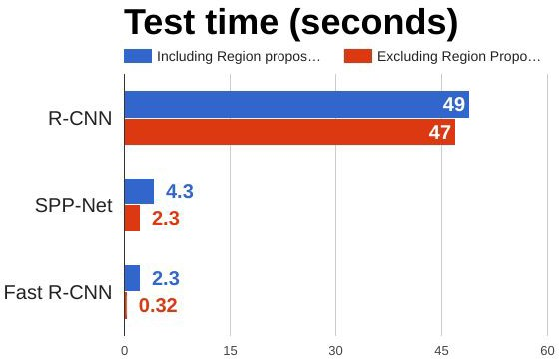
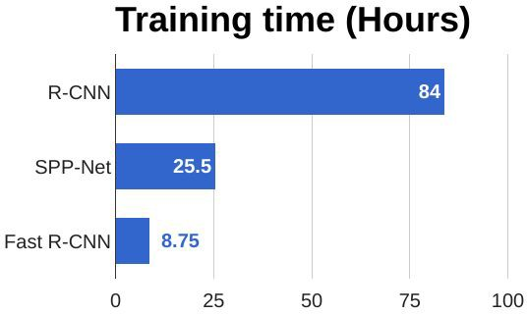
R-CNN vs Fast R-CNN
Girshick et al, “Rich feature hierarchies for accurate object detection and semantic segmentation”, CVPR 2014. He et al, “Spatial pyramid pooling in deep convolutional networks for visual recognition”, ECCV 2014
Girshick, “Fast R-CNN”, ICCV 2015
Lecture 9 -

Slide 46
R-CNN vs Fast R-CNN
Problem:
Runtime dominated by region proposals!
Girshick et al, “Rich feature hierarchies for accurate object detection and semantic segmentation”, CVPR 2014. He et al, “Spatial pyramid pooling in deep convolutional networks for visual recognition”, ECCV 2014
Girshick, “Fast R-CNN”, ICCV 2015
Lecture 9 -

Slide 47
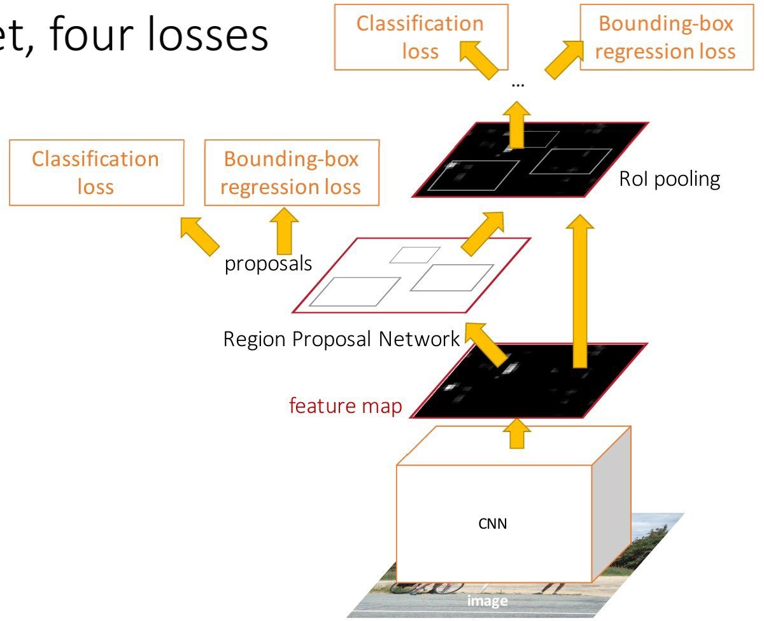
Faster R-CNN:
Make CNN do proposals!
Insert Region Proposal Network (RPN) to predict proposals from features
Otherwise same as Fast R-CNN: Crop features for each proposal, classify each one
Ren et al, “Faster R-CNN: Towards Real-Time Object Detection with Region Proposal Networks”, NIPS 2015 Figure copyright 2015, Ross Girshick; reproduced with permission
Lecture 9 -

Slide 48
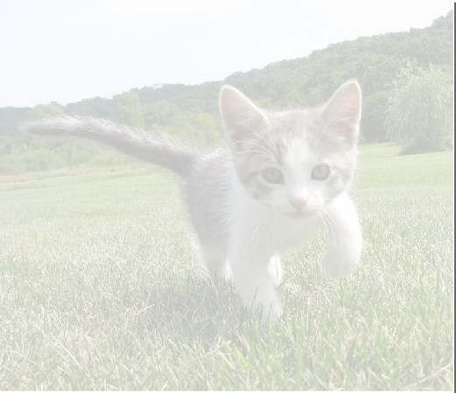
Region Proposal Network
CNN
Input Image (e.g. 3 x 640 x 480)
Image features (e.g. 512 x 20 x 15)
Lecture 9 -

Slide 49
Region Proposal Network
Imagine an anchor box of fixed size at each point in the feature map
CNN
Input Image (e.g. 3 x 640 x 480)
Image features
(e.g. 512 x 20 x 15)
Lecture 9 -

Slide 50
Region Proposal Network
Imagine an anchor box of fixed size at each point in the feature map
Anchor is an object?
1 x 20 x 15
CNN
Conv
At each point, predict whether the corresponding anchor contains an object (binary classification)
Input Image (e.g. 3 x 640 x 480)
Image features
(e.g. 512 x 20 x 15)
Lecture 9 -

Slide 51
Region Proposal Network
Imagine an anchor box of fixed size at each point in the feature map
Anchor is an object?
1 x 20 x 15
CNN
Conv
Box corrections 4 x 20 x 15
For positive boxes, also predict a corrections from the anchor to the ground-truth box (regress 4 numbers per pixel)
Input Image (e.g. 3 x 640 x 480)
Image features (e.g. 512 x 20 x 15)
Lecture 9 -

Slide 52
In practice use K different anchor boxes of different size / scale at each point
Region Proposal Network
Anchor is an object?
K x 20 x 15
CNN
Conv
Box transforms
4K x 20 x 15
Input Image (e.g. 3 x 640 x 480)
Image features (e.g. 512 x 20 x 15)
Lecture 9 -

Slide 53
In practice use K different anchor boxes of different size / scale at each point
Region Proposal Network
Anchor is an object?
K x 20 x 15
CNN
Conv
Box transforms
4K x 20 x 15
Sort the K*20*15 boxes by their “objectness” score, take top ~300 as our proposals
Input Image (e.g. 3 x 640 x 480)
Image features (e.g. 512 x 20 x 15)
Lecture 9 -

Slide 54
Faster R-CNN:
Make CNN do proposals!
Jointly train with 4 losses:
RPN classify object / not object
RPN regress box coordinates
Final classification score (object classes)
Final box coordinates
Ren et al, “Faster R-CNN: Towards Real-Time Object Detection with Region Proposal Networks”, NIPS 2015 Figure copyright 2015, Ross Girshick; reproduced with permission
Lecture 9 -

Slide 55
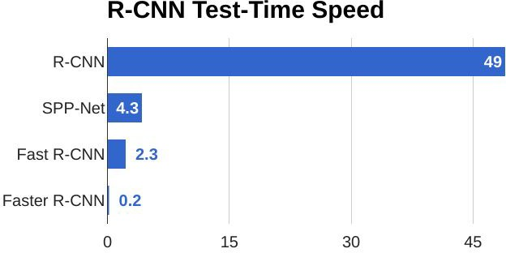
Faster R-CNN:
Make CNN do proposals!
Lecture 9 -

Slide 56
Faster R-CNN:
Make CNN do proposals!
Glossing over many details:
Ignore overlapping proposals with
non-max suppression
How are anchors determined?
How do we sample positive / negative samples for training the RPN?
How to parameterize bounding box regression?
Ren et al, “Faster R-CNN: Towards Real-Time Object Detection with Region Proposal Networks”, NIPS 2015 Figure copyright 2015, Ross Girshick; reproduced with permission
Lecture 9 -

Slide 57
Faster R-CNN:
Make CNN do proposals!
Faster R-CNN is a
Two-stage object detector
First stage: Run once per image
Backbone network
Region proposal network
Second stage: Run once per region
Crop features: RoI pool / align
Predict object class
Prediction bbox offset
Lecture 9 -

Slide 58
Faster R-CNN:
Make CNN do proposals!
Do we really need the second stage?
Faster R-CNN is a
Two-stage object detector
First stage: Run once per image
Backbone network
Region proposal network
Second stage: Run once per region
Crop features: RoI pool / align
Predict object class
Prediction bbox offset
Lecture 9 -

Slide 59
Single-Stage Object Detectors: YOLO / SSD / RetinaNet
Within each grid cell:
Regress from each of the B base boxes to a final box with 5 numbers:
(dx, dy, dh, dw, confidence)
Predict scores for each of C classes (including background as a class)
Looks a lot like RPN, but category-specific!
Input image 3 x H x W
Divide image into grid 7 x 7
Image a set of base boxes centered at each grid cell Here B = 3
Output:
7 x 7 x (5 * B + C)
Redmon et al, “You Only Look Once:
Unified, Real-Time Object Detection”, CVPR 2016
Liu et al, “SSD: Single-Shot MultiBox Detector”, ECCV 2016 Lin et al, “Focal Loss for Dense Object Detection”, ICCV 2017
Lecture 9 -

Slide 60
Object Detection: Lots of variables ...
Backbone Network VGG16
ResNet-101 Inception V2 Inception V3 Inception ResNet MobileNet
“Meta-Architecture”
Two-stage: Faster R-CNN Single-stage: YOLO / SSD Hybrid: R-FCN
Takeaways
Faster R-CNN is slower but more accurate
SSD is much faster but not as accurate
Image Size
# Region Proposals
…
Bigger / Deeper backbones work better
Huang et al, “Speed/accuracy trade-offs for modern convolutional object detectors”, CVPR 2017
R-FCN: Dai et al, “R-FCN: Object Detection via Region-based Fully Convolutional Networks”, NIPS 2016
Inception-V2: Ioffe and Szegedy, “Batch Normalization: Accelerating Deep Network Training by Reducing Internal Covariate Shift”, ICML 2015 Inception V3: Szegedy et al, “Rethinking the Inception Architecture for Computer Vision”, arXiv 2016
Inception ResNet: Szegedy et al, “Inception-V4, Inception-ResNet and the Impact of Residual Connections on Learning”, arXiv 2016 MobileNet: Howard et al, “Efficient Convolutional Neural Networks for Mobile Vision Applications”, arXiv 2017
Lecture 9 -

Slide 61
Object Detection: Lots of variables ...
Backbone Network VGG16
ResNet-101 Inception V2 Inception V3 Inception ResNet MobileNet
“Meta-Architecture”
Two-stage: Faster R-CNN Single-stage: YOLO / SSD Hybrid: R-FCN
Takeaways
Faster R-CNN is slower but more accurate
SSD is much faster but not as accurate
Image Size
# Region Proposals
…
Bigger / Deeper backbones work better
Huang et al, “Speed/accuracy trade-offs for modern convolutional object detectors”, CVPR 2017 Zou et al, “Object Detection in 20 Years: A Survey”, arXiv 2019
R-FCN: Dai et al, “R-FCN: Object Detection via Region-based Fully Convolutional Networks”, NIPS 2016
Inception-V2: Ioffe and Szegedy, “Batch Normalization: Accelerating Deep Network Training by Reducing Internal Covariate Shift”, ICML 2015 Inception V3: Szegedy et al, “Rethinking the Inception Architecture for Computer Vision”, arXiv 2016
Inception ResNet: Szegedy et al, “Inception-V4, Inception-ResNet and the Impact of Residual Connections on Learning”, arXiv 2016 MobileNet: Howard et al, “Efficient Convolutional Neural Networks for Mobile Vision Applications”, arXiv 2017
Lecture 9 -

Slide 62
Instance Segmentation
Semantic Segmentation
Object Detection
Instance Segmentation
Classification
CAT
GRASS, CAT, TREE, SKY
DOG, DOG, CAT
DOG, DOG, CAT
No spatial extent
No objects, just pixels
Multiple Object
Lecture 9 -

Slide 63
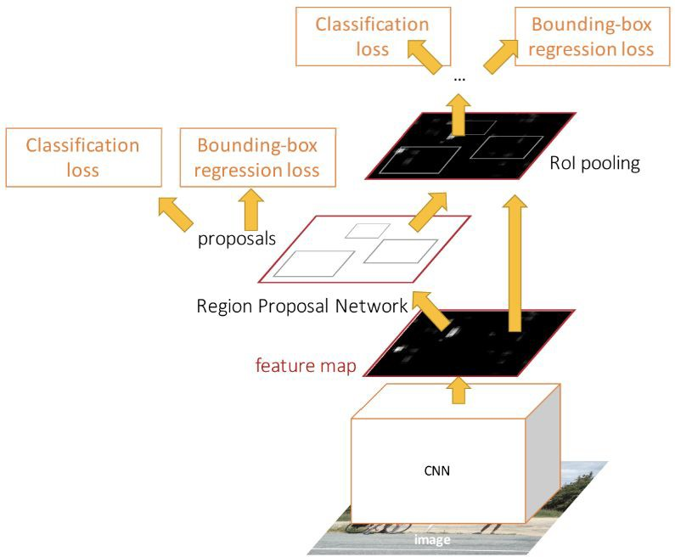
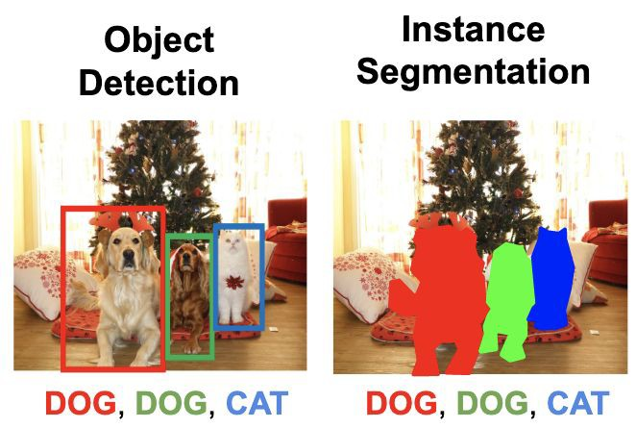
Object Detection: Faster R-CNN
Lecture 9 -

Slide 64
Open Source Frameworks
Lots of good implementations on GitHub!
TensorFlow Detection API:
https://github.com/tensorflow/models/tree/master/research/object_detection Faster RCNN, SSD, RFCN, Mask R-CNN, ...
Detectron2 (PyTorch)
https://github.com/facebookresearch/detectron2
Mask R-CNN, RetinaNet, Faster R-CNN, RPN, Fast R-CNN, R-FCN, ...
Finetune on your own dataset with pre-trained models
Lecture 9 -

